Slide 1

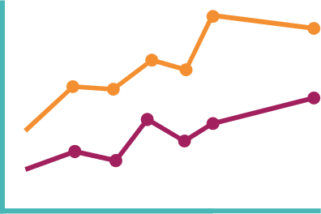







Main finding goes here, translated into plain English. Emphasize the important words.
Jiří Novák
Non-Cognitive Predictors of Student Success: A Predictive Validity Comparison Between Domestic and International Students
Anonymization of longitudinal demographic data
AMMO BAR
Delete this and replace it with your…
Extra Graphs
Extra Correlation tables
Extra Figures
Extra nuance that you’re worried about leaving out.
Keep it messy! This section is just for you.
Jiří Novák
- University of Zürich
- University of Applied Sciences Northwestern Switzerland
- Swiss Data Anonymization Competence Center
BACKGROUND: Longitudinal data analysis, which involves repeated observations of individuals, is valuable source of information, but limited by data protection laws. Techniques like Statistical Disclosure Control and Synthetic data generation are essential for safe data use. However, there's a notable research gap for longitudinal data, particularly in fields like health and mobile traffic, where data must often be detailed for meaningful analysis.
METHODS
Collected [what] from [population]
Tested it with X process.
Illustrate your methods if you can.
Try a flowchart!
RESULTS
Graph/table with essential results only.
All the other correlations in the ammo bar.
Visualize your findings with an image, graphic, or a key figure.
Open Science, Open Access, Open Data
Research data that results from publicly funded research should be
findable, accessible, interoperable, reusable (‘FAIR principles’)
therefore replicable, transparent, trustworthy
as open as possible, as closed as necessary
Commission Recommendation (EU) 2018/790 on access to and preservation of scientific information
Acknowledgments
This work was funded by the Swiss National Science Foundation with grant number 211751: "Harnessing event and longitudinal data in industry and health sector through privacy preserving technologies".
Take a picture to download

